Slide 1
Connect and cognify nearly every thing, place, and service
Jorge Fonseca (he/him)
Senior Solutions Architect
Amazon Web Services
Notes:
Welcome to the AWS Unlocking the potential of IoT in Travel and Hospitality Session. I’m SriHari Thotapalli, Principal Solutions Architect for AWS Travel & Hospitality. We are grateful that you’re able to join us today.
Abstract: Travel and hospitality companies looking to meet customer expectations and differentiate themselves from their competitors are turning to the Internet of Things (IoT). In this session, you will learn how early adopters are using IoT to develop connected kitchen and hotel room experiences, implement airline bag tracking solutions and aircraft turn tracking solutions, and more. Discover how you can take advantage of the latest IoT advancements to improve your business outcomes.

Slide 2

The book
2016
3 decades since the birth of the internet
tech forces that will shape the next 30 years

Slide 3
The forces
Sharing
• Tracking
• Accessing
• Beginning
Screening
• Questioning
• Remixing
• Flowing
Cognifying
• Becoming
• Interacting
• Filtering
What’s taking us so long?
🤔
Notes:
We could categorize these forces into 3 main pillars: SHARING (in a future where all humans and machines will be connected in an ecosystem supported by the Internet), SCREENING (in the sense that, one day, humans will interact with screens everywhere), and COGNIFYING (when any thing NOT interactive, will be considered broken). I remember how excited I got with this positive view of the future of humankind, and how I found myself asking: "what's takings us so long?"

Slide 4
The forces
Cognifying
• Becoming
• Interacting
• Filtering
Screening
• Questioning
• Remixing
• Flowing
Sharing
• Tracking
• Accessing
• Beginning
What’s taking us so long?
🤔

Slide 5



Agenda
Sharing
Screening
Cognifying
Why?
How?
Where?
Notes:
If you think that's too much content in one go, then you are probably right. To make it easier to digest, we'll break the session into 3 parts. First, we will work backwards from the cognifying goal, to understand why we need all 3 pillars. Then, we will see how the building blocks connect with one another from the ground up. And finally, I'll share with you the hyper links to the specifications and source code that you need to integrate your applications into this ecosystem TODAY.

Slide 6
Agenda
Cognifying
Screening
Sharing
Why?
How?
Where?

Slide 7
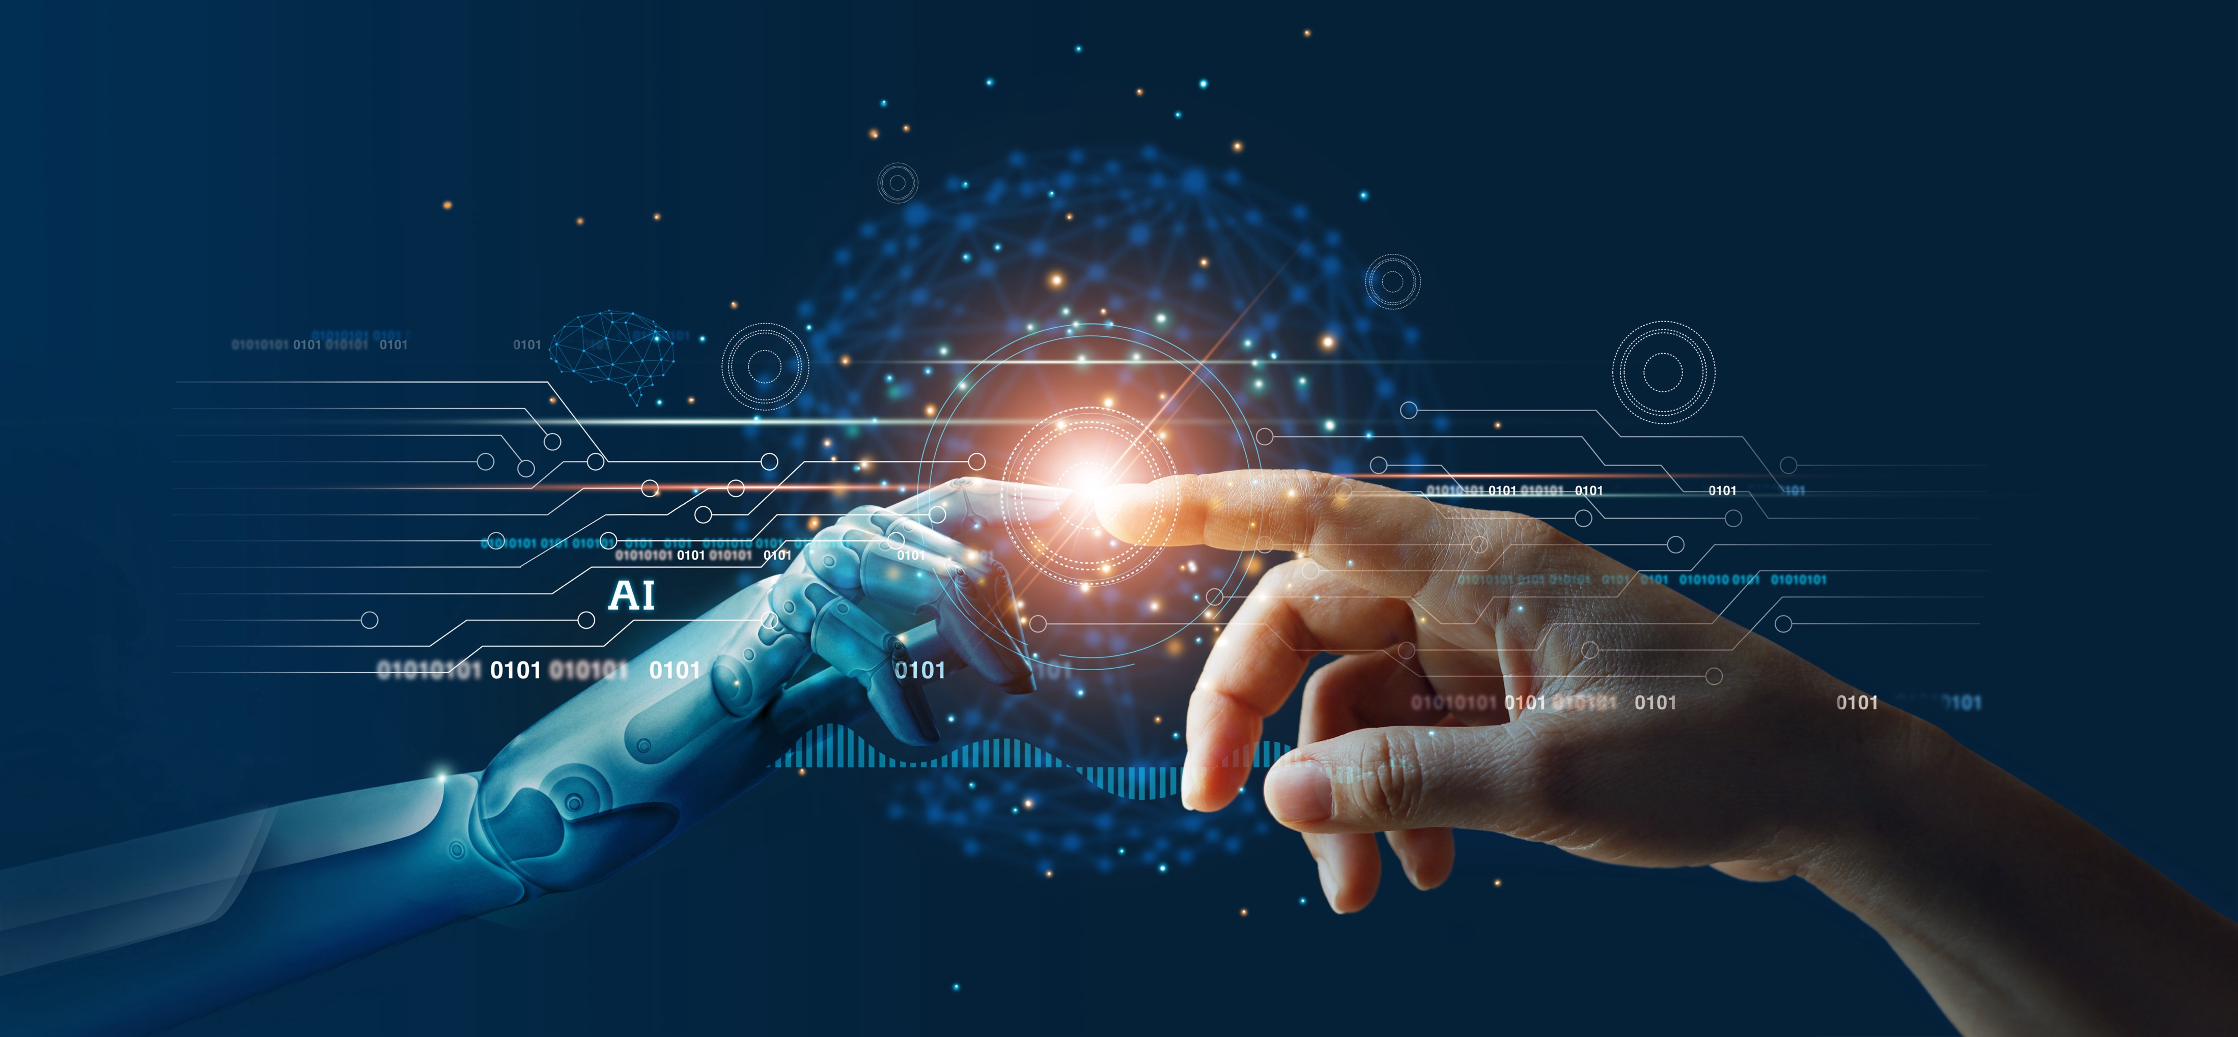
Cognifying
• Becoming
• Interacting
• Filtering
Screening
• Questioning
• Remixing
• Flowing
Sharing
• Tracking
• Accessing
• Beginning
Cognifying
A.I. will cognify objects, making them intelligent
✅ smart things: lights, thermostats
⚠️ most home appliances still dumb
Tap to cognify?
🤔

Slide 8

Cognifying
• Becoming
• Interacting
• Filtering
Screening
• Questioning
• Remixing
• Flowing
Sharing
• Tracking
• Accessing
• Beginning
Becoming
All things will upgrade via internet
✅ software, 5.6B internet users (64%), Starlink, Kuiper
⚠️ few things are connected (Wi-Fi, 2G/5G)
Tap to connect?
🤔

Slide 9
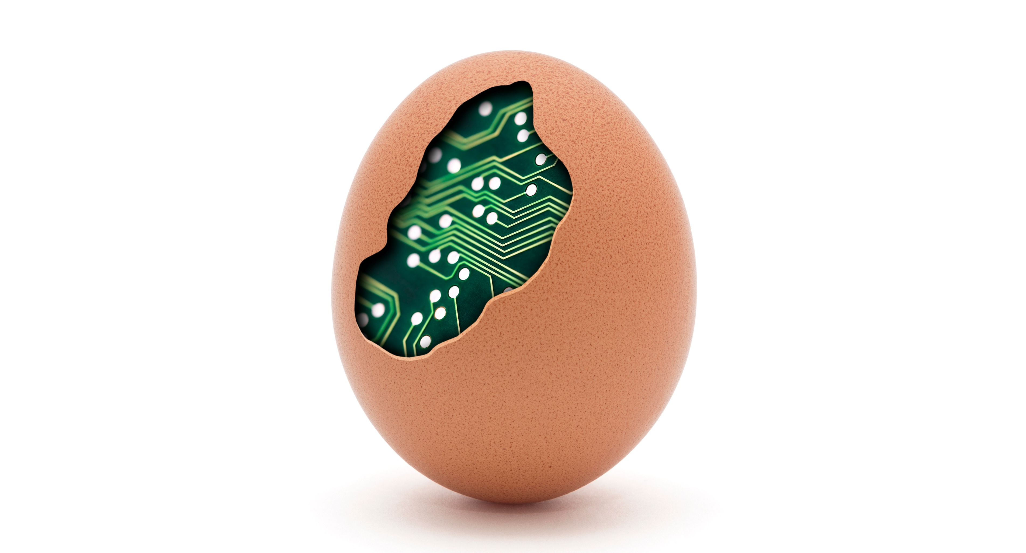
Cognifying
• Becoming
• Interacting
• Filtering
Screening
• Questioning
• Remixing
• Flowing
Sharing
• Tracking
• Accessing
• Beginning
Interacting
Anything not interactive will be considered broken
✅ tablets in cars dashboards, restaurants, stores
⚠️ children touch things in museums as if tablets
Ship physical products
that come to life with a tap?
🤔

Slide 10

Cognifying
• Becoming
• Interacting
• Filtering
Screening
• Questioning
• Remixing
• Flowing
Sharing
• Tracking
• Accessing
• Beginning
Filtering
We’ll customize/personalize, anticipate experiences
✅ machine learning predictions: media, shopping
⚠️ average, not unique – guessing, not asking
Tap to share your seat preferences,
food allergies, and favourite dishes?
🤔

Slide 11

Cognifying
• Becoming
• Interacting
• Filtering
Screening
• Questioning
• Remixing
• Flowing
Sharing
• Tracking
• Accessing
• Beginning
Screening
Screens will be in every object, adapting to users
✅ 6.8B smartphones, 86% of global population
⚠️ hard/costly to build UX in X-small UI
Tap to display on your phone
the UI of any thing/place/service?
🤔

Slide 12
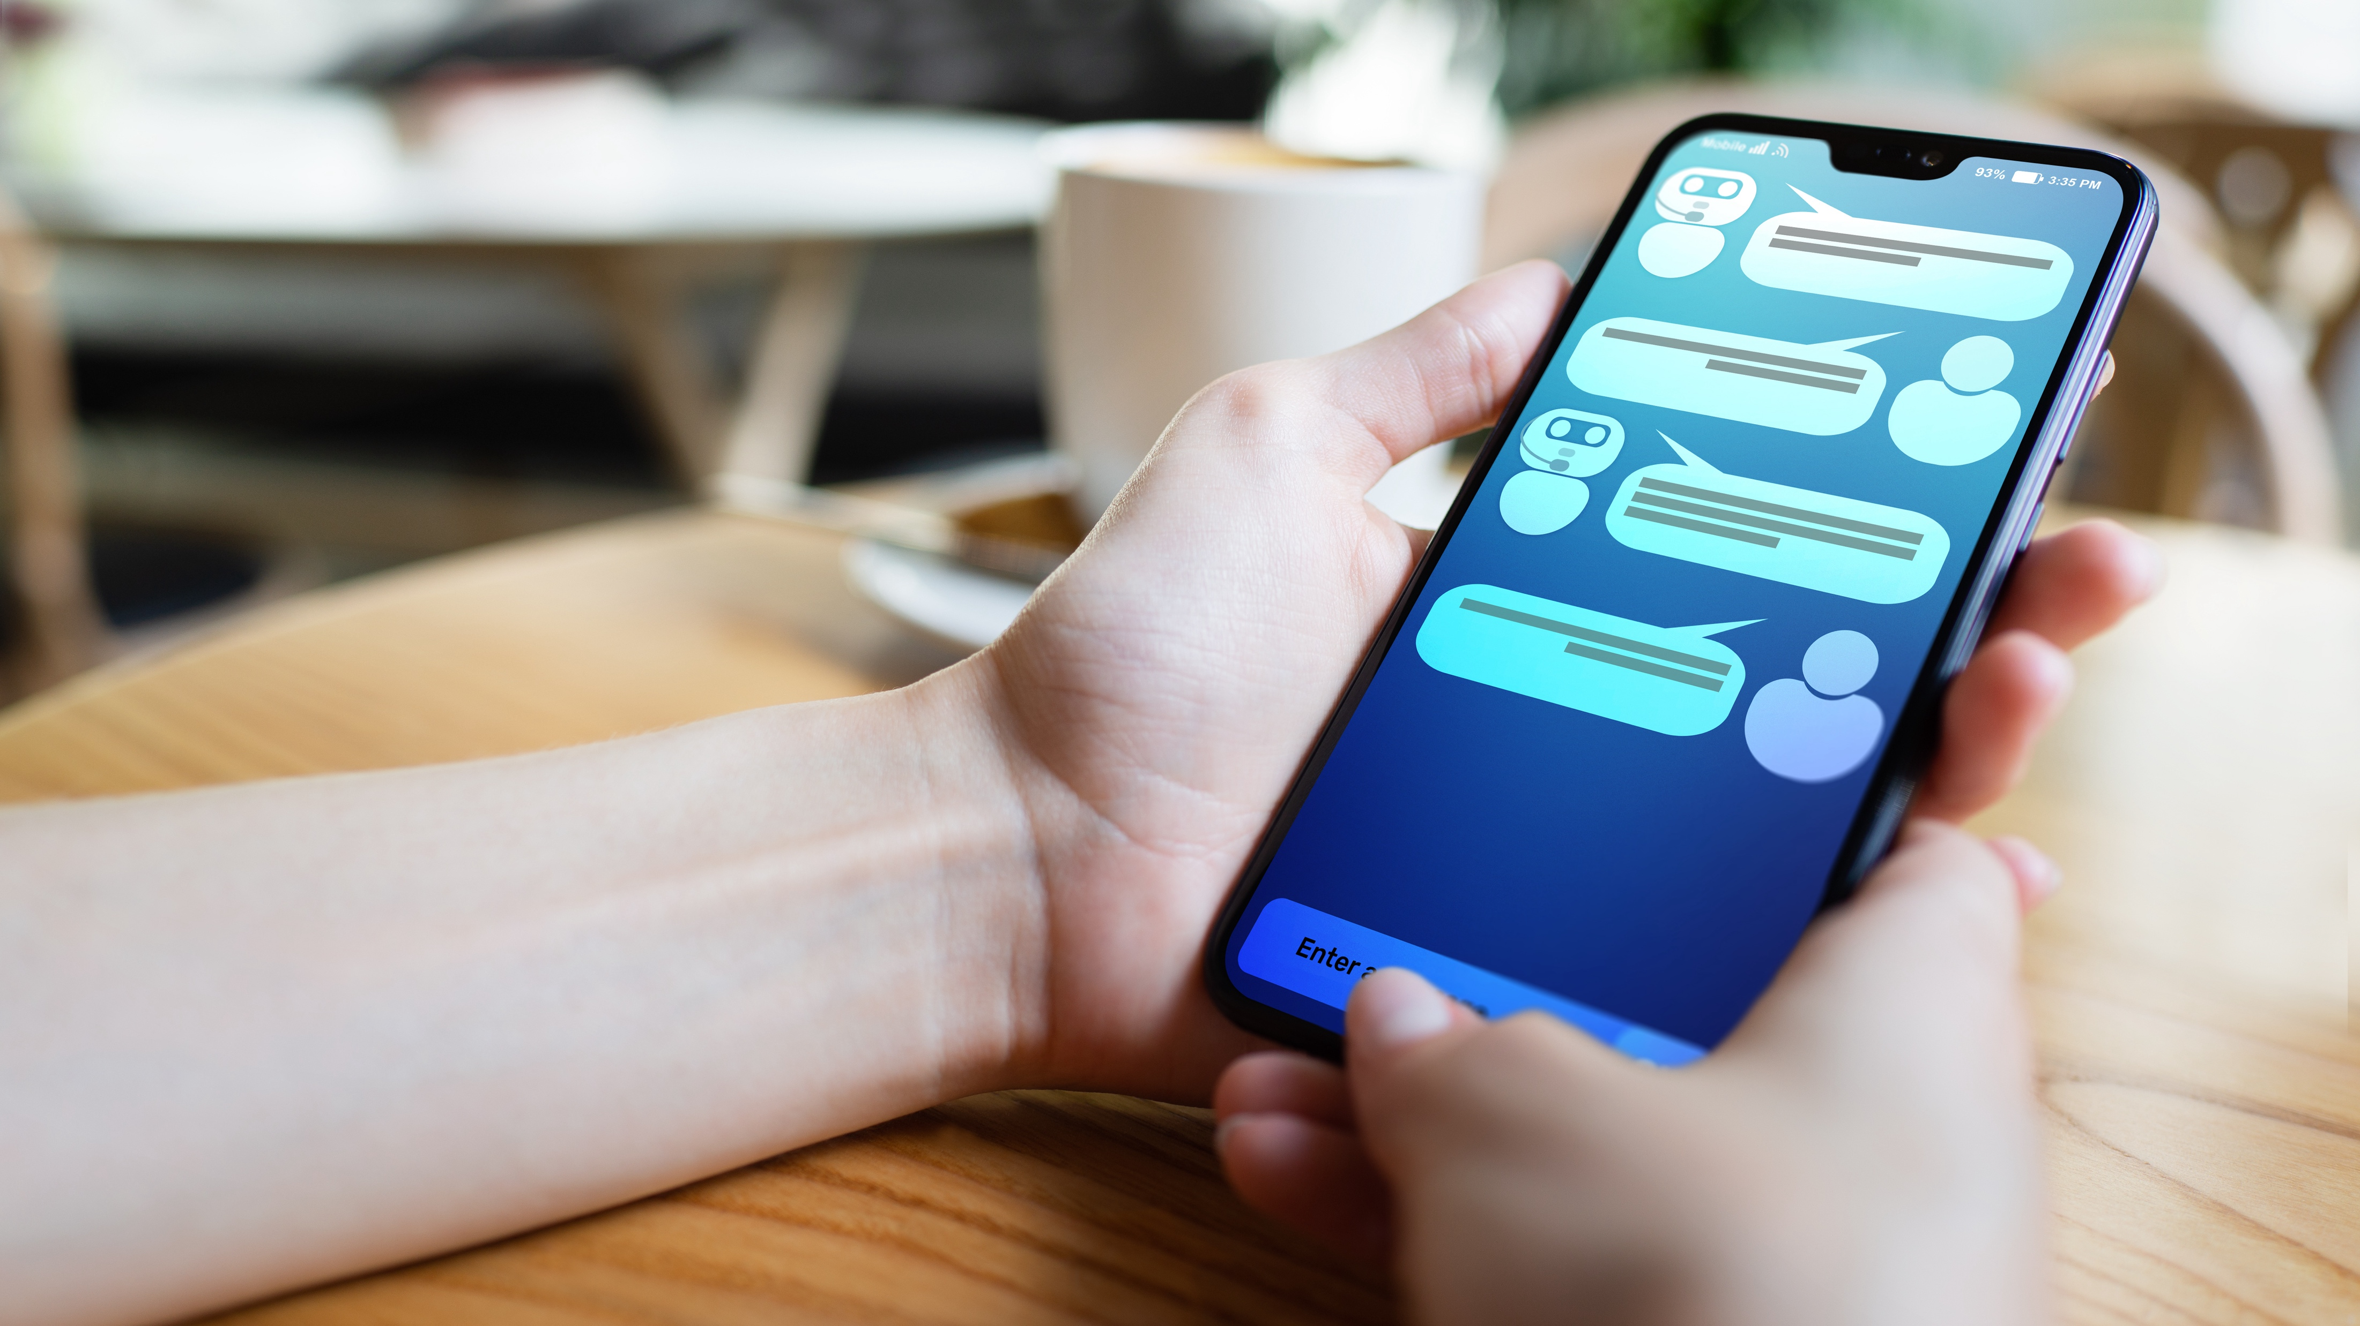
Cognifying
• Becoming
• Interacting
• Filtering
Screening
• Questioning
• Remixing
• Flowing
Sharing
• Tracking
• Accessing
• Beginning
Questioning
Good questions +valuable than good answers
✅ generative AI, search engines
⚠️ most UI interactions are fixed command buttons
Q&A dialogs
with any thing/place/service?
🤔

Slide 13

Cognifying
• Becoming
• Interacting
• Filtering
Screening
• Questioning
• Remixing
• Flowing
Sharing
• Tracking
• Accessing
• Beginning
Remixing
We’ll combine primitive parts into new data flows
✅ app OS, cloud building blocks
⚠️ tax return forms, service registration/onboarding
Composable no-text UX flows?
(share, choose, confirm, pay)
🤔

Slide 14

Cognifying
• Becoming
• Interacting
• Filtering
Screening
• Questioning
• Remixing
• Flowing
Sharing
• Tracking
• Accessing
• Beginning
Flowing
We’ll depend on unstoppable streams
✅ social networks, streaming, real-time banking
⚠️ ad revenue driven, spam, right to be forgotten
Check-in to interact,
check-out to forget?
🤔

Slide 15
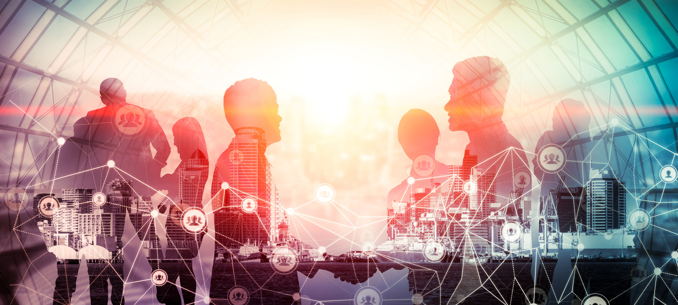
Cognifying
• Becoming
• Interacting
• Filtering
Screening
• Questioning
• Remixing
• Flowing
Sharing
• Tracking
• Accessing
• Beginning
Sharing
We’ll share everything
✅ social, work, videos, tap to pay
⚠️ covid certificates
Authorize disclosure
between trusted domains?
🤔

Slide 16
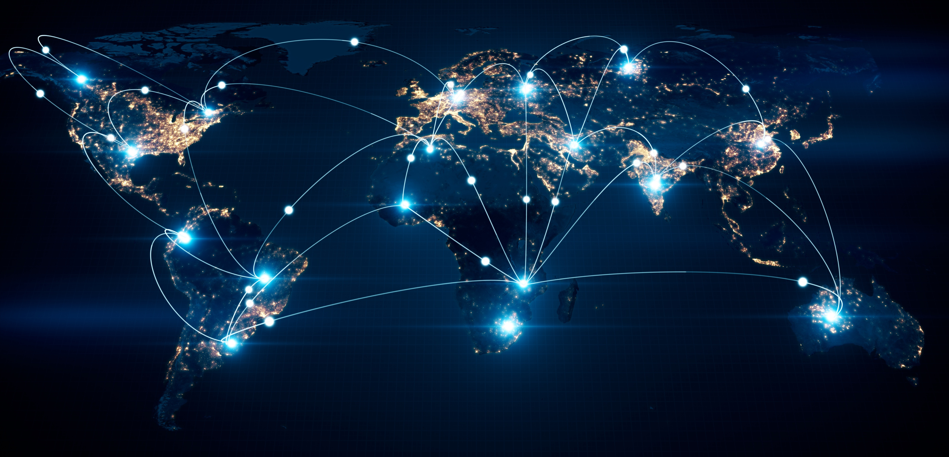
Cognifying
• Becoming
• Interacting
• Filtering
Screening
• Questioning
• Remixing
• Flowing
Sharing
• Tracking
• Accessing
• Beginning
Tracking
Every activity will be recorded, for user’s benefit
✅ fit band, navigation apps, loyalty cards, city cameras
⚠️ data silos
Share your aggregated life stream
with any thing/place/service?
🤔

Slide 17
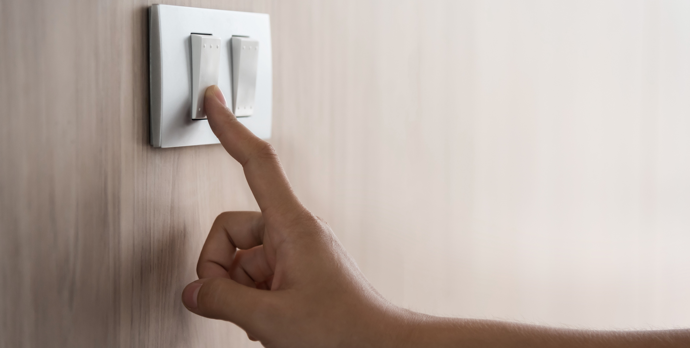
Cognifying
• Becoming
• Interacting
• Filtering
Screening
• Questioning
• Remixing
• Flowing
Sharing
• Tracking
• Accessing
• Beginning
Accessing
We’ll use when needed, instead of owning
✅ video/music streaming, cloud compute
⚠️ drivers’ identity fraud, racial biases, religious choices
Show your hand to cross a border
at any international airport?
🤔

Slide 18
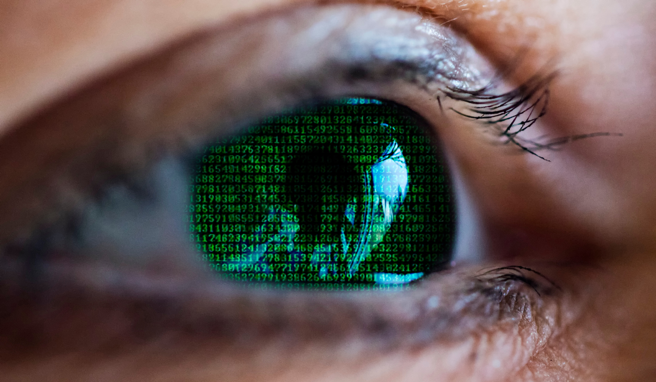
Cognifying
• Becoming
• Interacting
• Filtering
Screening
• Questioning
• Remixing
• Flowing
Sharing
• Tracking
• Accessing
• Beginning
Beginning
We’ll connect all humans and machines globally
✅ internet
⚠️ ambient computing, metaverse

Slide 19
About me

Slide 20
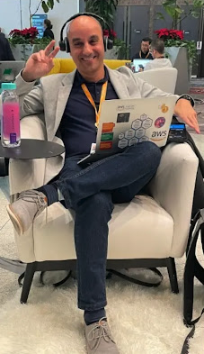

About me
Jorge Fonseca (he/him)
Senior Solutions Architect Amazon Web Services
linkedin.com/in/jorgefonseca

Slide 21
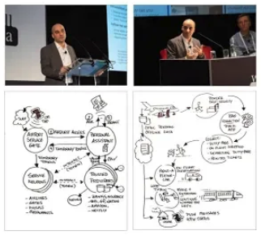
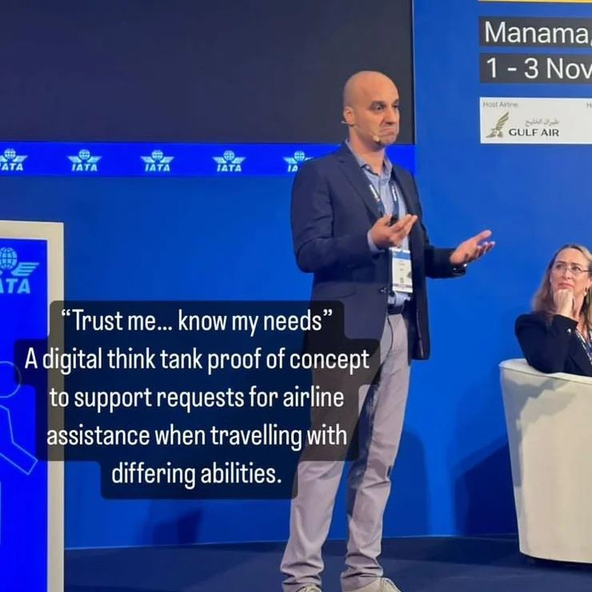
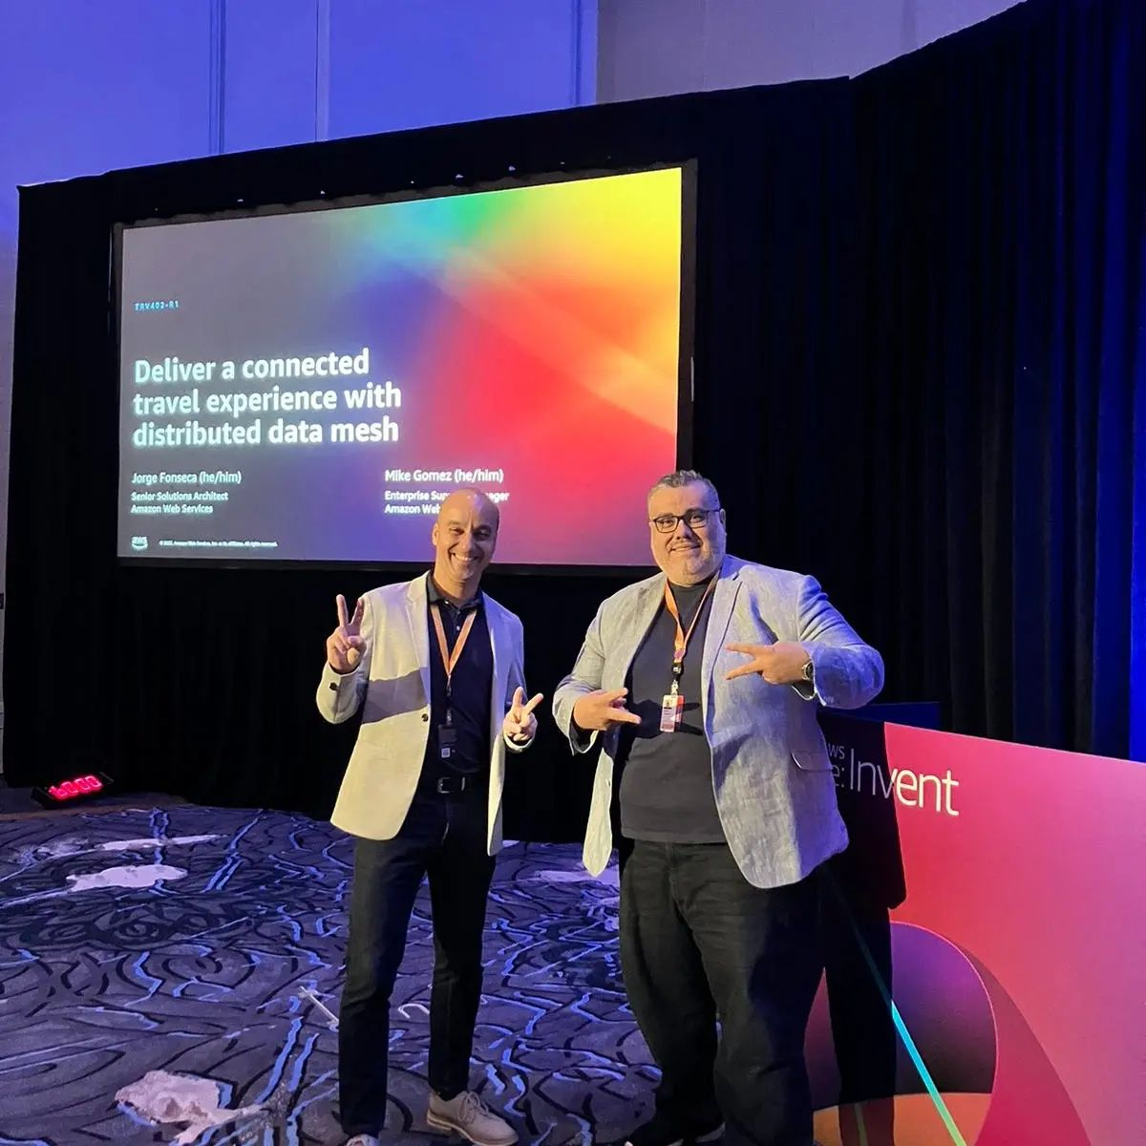
About the past
2018 @ London, UK Enterprise Cloud Comp. conf.
The future of customer experience in commercial aviation
2022 @ Manama, Bahrain World Passenger Symposium
IATA Digital Think Tank Trust me, know my needs W3C DIDs, VCs, DIDcomm
2022 @ Las Vegas, USA AWS re:Invent
Deliver a connected travel experience with distributed data mesh

Slide 22
About the future
Share with trust
Domain trust framework Decentralized backbone
Remix user screens
UI primitive parts Session dialogs
Cognify everything
One tap to connect One tap interactions

Slide 23
Sharing
• Trusting
• Securing
• Paying
Screening
• Interacting
• Forgetting
Cognifying
• Connecting
• Animating
• Accessing
Sharing
👥 Domain
📜 manifests?
🗄️ Vault
0
bind
1
{tokens}
C
disclose
2
👥 Domain
🏛️ Authority
🧑‍🦰 Wallet: App
share?
A
B
{tokens}
0
D
{info}
👥 Domain
🔎 Consumer
📜 manifests?

Slide 24
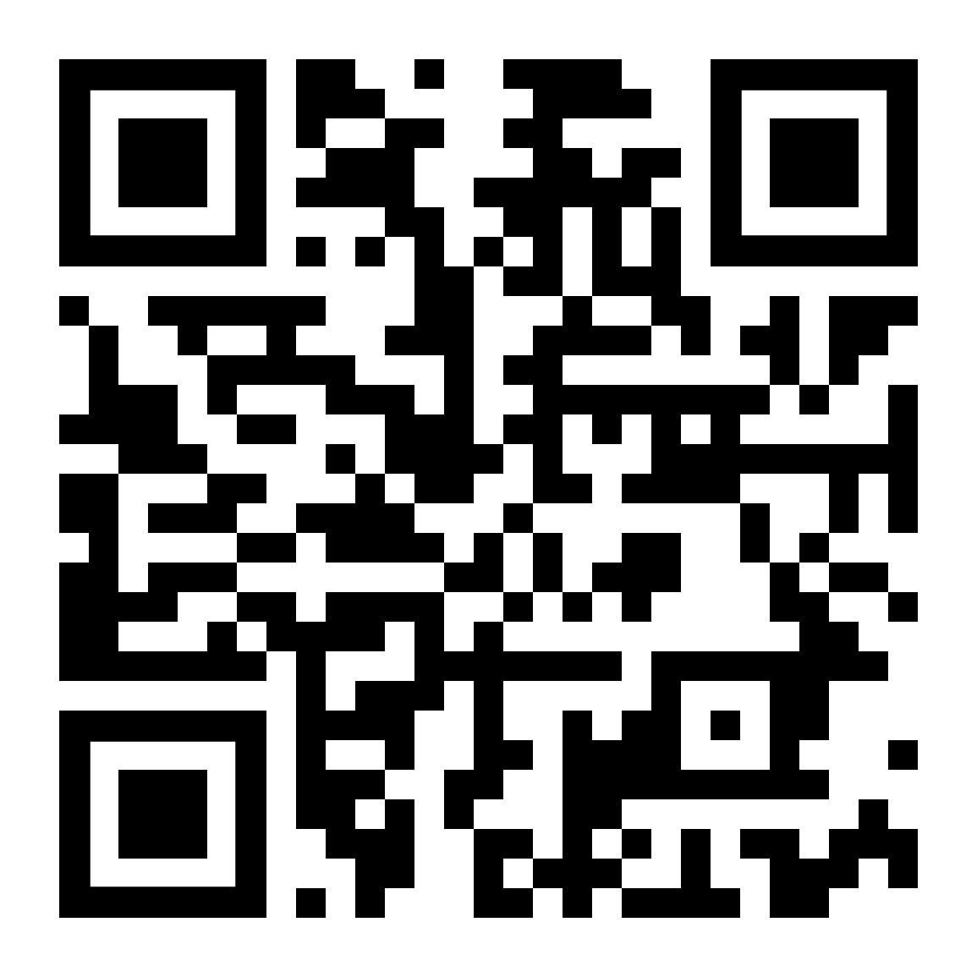
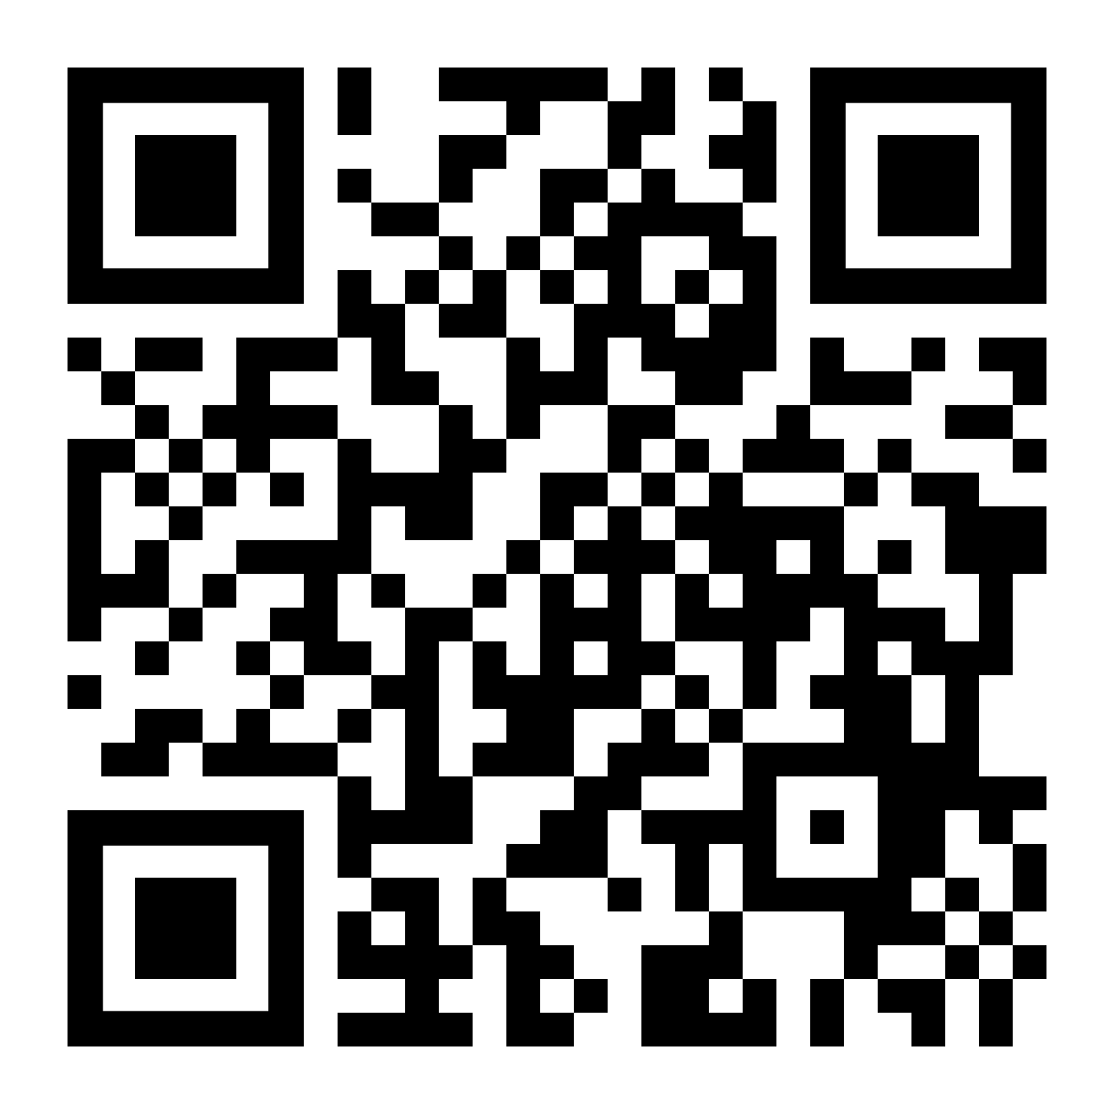
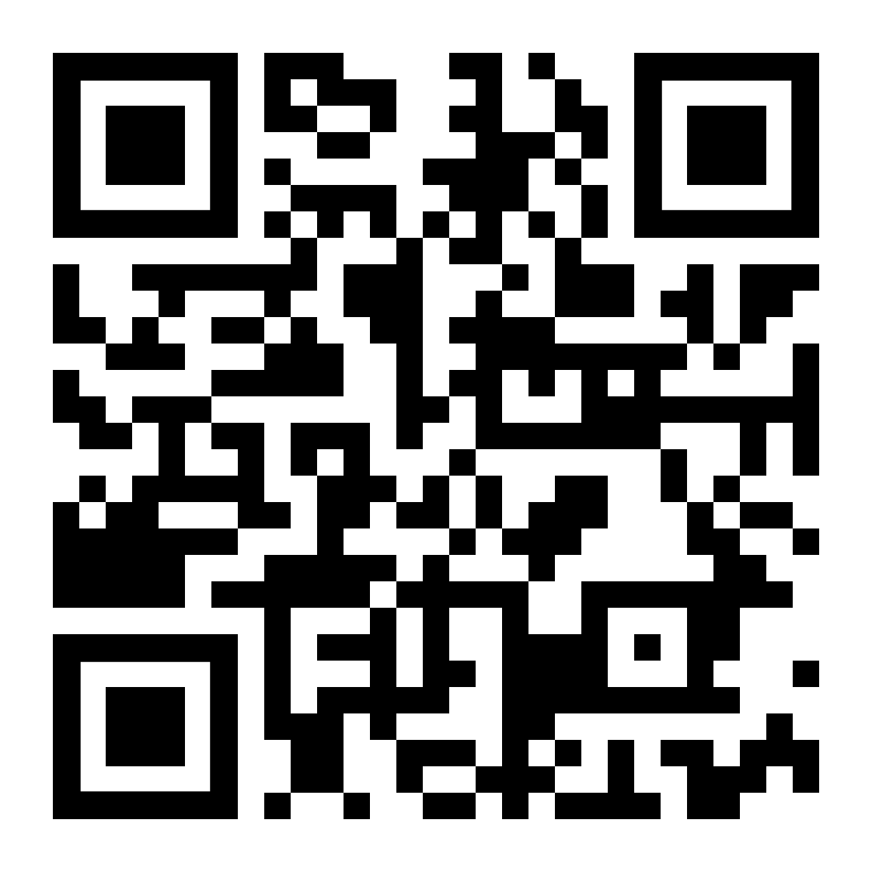
Sharing
• Trusting
• Securing
• Paying
Screening
• Interacting
• Forgetting
Cognifying
• Connecting
• Animating
• Accessing
Sharing
What about Solid, Web 3.0, and Web3?
👥 Domain
🤔
📜 manifests?
🗄️ Vault
0
bind
1
{credentials}
C
disclose
Why not Decentralized Identifiers (DIDs) with distributed ledgers (SSI, Sovrin)?
2
👥 Domain
🤔
🏛️ Authority
🧑‍🦰 Wallet: App
share?
A
B
{credentials}
Same as Data Spaces (Gaia-X, Catena-X)?
0
D
{info}
👥 Domain
🤔
🔎 Consumer
📜 manifests?

Slide 25
Sharing
• Trusting
• Securing
• Paying
Screening
• Interacting
• Forgetting
Cognifying
• Connecting
• Animating
• Accessing
Trusting
😌 trusts
👥 Domain A
👥 Domain B
📜
📜 manifest
😌 trusts
😌 trusts
👥 Domain
👥 Domain
🗄️ Vault
📜
👂 Listeners
📜
🔎 Consumer
🌬️ fan-out
trust receiver with this type of info? 🤔
trust this type of info from this sender? 🤔
🕸 Graphs
_{ℹ️} user info

Slide 26
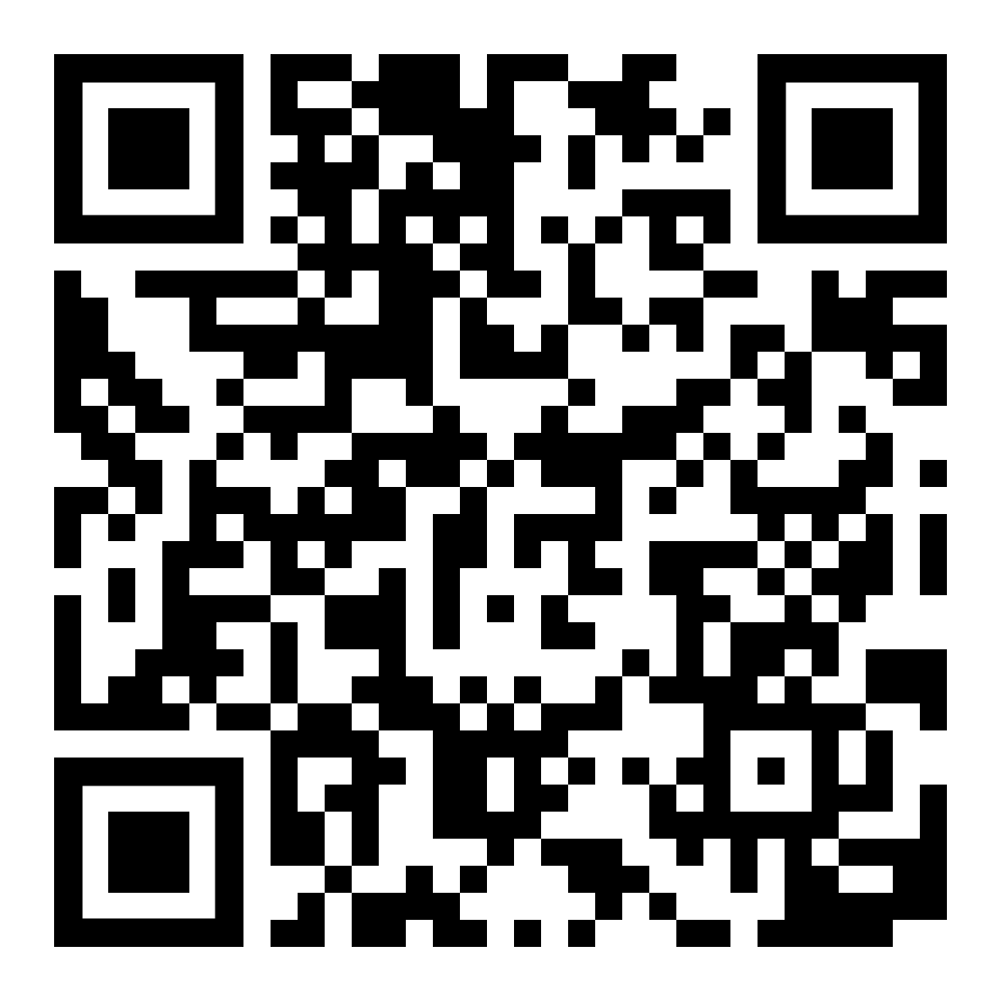
Sharing
• Trusting
• Securing
• Paying
Screening
• Interacting
• Forgetting
Cognifying
• Connecting
• Animating
• Accessing
Trusting
😌 trusts
👥 Domain A
👥 Domain B
📜 manifest
Why not the
Public Key Infrastructure (PKI)?
😌 trusts
📜
😌 trusts
👥 Domain
👥 Domain
🤔
🗄️ Vault
📜
👂 Listeners
📜
🔎 Consumer
🌬️ fan-out
trust receiver with this type of info? 🤔
trust this type of info from this sender? 🤔
🕸 Graphs
_{ℹ️} user info

Slide 27
Sharing
• Trusting
• Securing
• Paying
Screening
• Interacting
• Forgetting
Cognifying
• Connecting
• Animating
• Accessing
Securing
is it DNSSEC? 🤔
🅰️ HTTPS webhook endpoints
📚 DNS 2
where are the receiver’s endpoints? 🤔
👥 Domain 1
👥 Domain 2
🔐 DKIM public key
is it DNSSEC? 🤔
📚 DNS 1
signed by sender? 🤔
🔐 signed message

Slide 28
Sharing
• Trusting
• Securing
• Paying
Screening
• Interacting
• Forgetting
Cognifying
• Connecting
• Animating
• Accessing
Securing
is it DNSSEC? 🤔
🅰️ HTTPS webhook endpoints
📚 DNS 2
where are the receiver’s endpoints? 🤔
Why not
W3C DIDcomm?
👥 Domain 1
👥 Domain 2
🤔
🔐 DKIM public key
is it DNSSEC? 🤔
📚 DNS 1
signed by sender? 🤔
🔐 signed message

Slide 29
Sharing
• Trusting
• Securing
• Paying
Screening
• Interacting
• Forgetting
Cognifying
• Connecting
• Animating
• Accessing
Paying
🧑‍🦰 User (buyer)
👥 Company (seller)
charge
_{👥 Domain}
🧑‍🦰 Wallet: App
1
💸 Seller
2
pay
4
paid!
🗄️ Vault
🗄️ Vault
💳 Payer
3
🏦 Collector
bind
collect
register
0
0

Slide 30
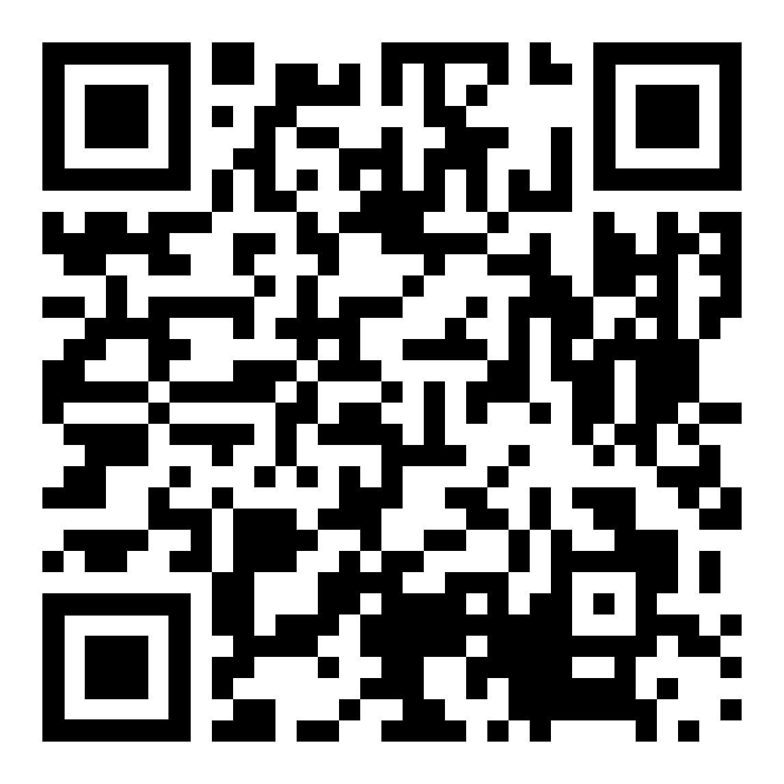
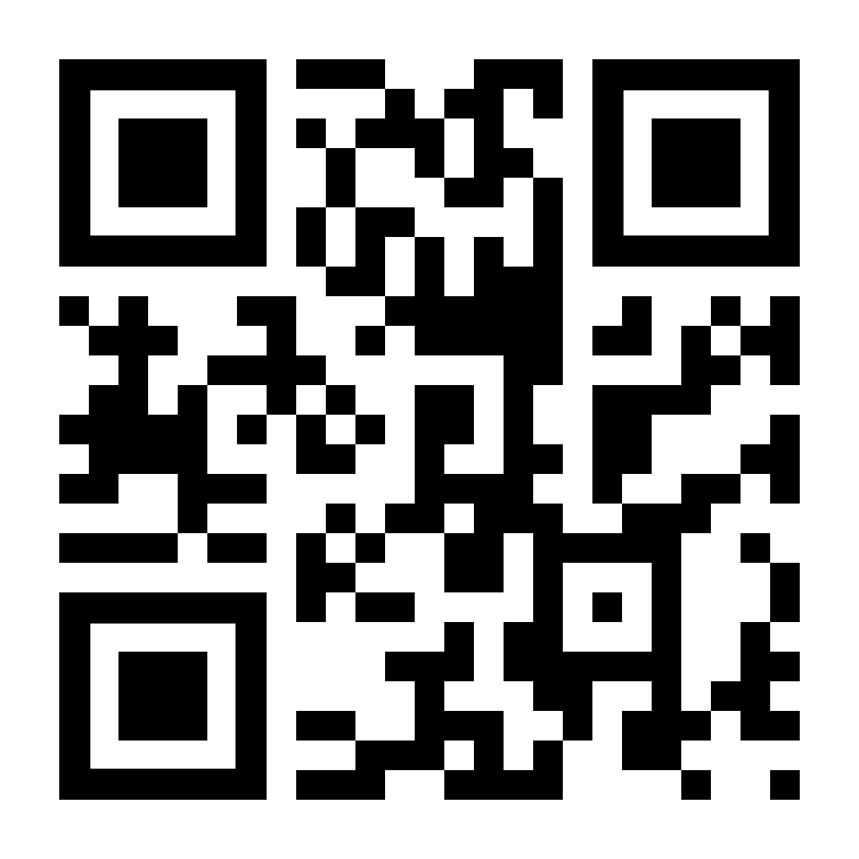
Sharing
• Trusting
• Securing
• Paying
Screening
• Interacting
• Forgetting
Cognifying
• Connecting
• Animating
• Accessing
Paying
🧑‍🦰 User (buyer)
👥 Company (seller)
charge
_{👥 Domain}
Why not
NFC contactless payments?
🧑‍🦰 Wallet: App
1
💸 Seller
🤔
2
pay
4
paid!
🗄️ Vault
🗄️ Vault
Same as Open Network for
Digital Commerce (ONDC)?
💳 Payer
3
🏦 Collector
bind
collect
register
🤔
0
0

Slide 31
Sharing
• Trusting
• Securing
• Paying
Screening
• Interacting
• Forgetting
Cognifying
• Connecting
• Animating
• Accessing
Screening
👥 Domain
1
✉️
🤗 Host
✉️ answer
💬 prompt
💬
👥 Domain
👥 Domain
wallets
binds
creds
🤵 Broker 1
🤵 Broker 2
👥 Domain
👥
📣 Notifier
📣
🧑‍🦰 Wallet: App
2
🧑‍🦰
📣 alert
📣

Slide 32
Sharing
• Trusting
• Securing
• Paying
Screening
• Interacting
• Forgetting
Cognifying
• Connecting
• Animating
• Accessing
Screening
👥 Domain
1
✉️
🤗 Host
✉️ answer
Same as
Beckn protocol?
💬 prompt
💬
👥 Domain
🤔
👥 Domain
wallets
binds
creds
🤵 Broker 1
🤵 Broker 2
👥 Domain
👥
📣 Notifier
📣
🧑‍🦰 Wallet: App
2
🧑‍🦰
📣 alert
📣

Slide 33
Sharing
• Trusting
• Securing
• Paying
Screening
• Interacting
• Forgetting
Cognifying
• Connecting
• Animating
• Accessing
Interacting
check in
1
🧑‍🦰 Wallet: App
A
disclose
🤵 Broker
📣
3
👥 Domain
😃 session talker
👥 Domain
2
B
🤗 Host
💬 prompts 💬 sharing 💬 bindings 💬 tokens 💬 payments 💬 goodbye!
🗄️ Vault
sessions
disclosures
C
_{ℹ️} user info

Slide 34
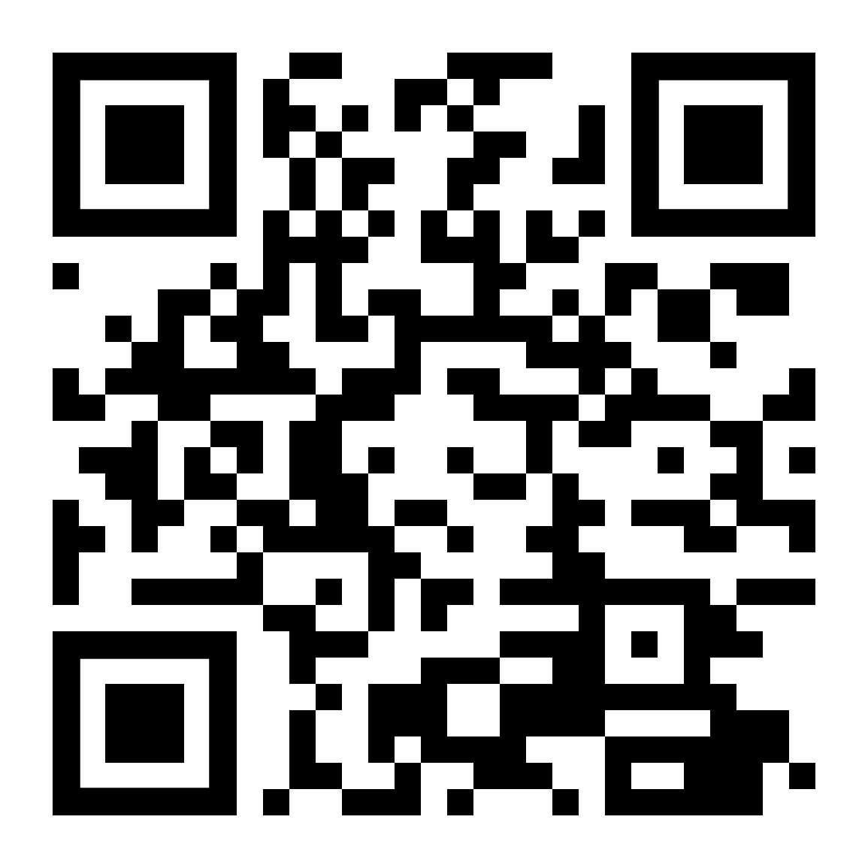
Sharing
• Trusting
• Securing
• Paying
Screening
• Interacting
• Forgetting
Cognifying
• Connecting
• Animating
• Accessing
Interacting
check in
1
🧑‍🦰 Wallet: App
A
disclose
🤵 Broker
📣
Same as super apps (Alipay, Grab, WeChat)?
3
🤔
👥 Domain
😃 session talker
👥 Domain
2
B
🤗 Host
💬 prompts 💬 sharing 💬 bindings 💬 credentials 💬 payments 💬 goodbye!
🗄️ Vault
sessions
disclosures
C
_{ℹ️} user info

Slide 35
Sharing
• Trusting
• Securing
• Paying
Screening
• Interacting
• Forgetting
Cognifying
• Connecting
• Animating
• Accessing
Forgetting
🧑‍🦰 Wallet: App
1
4
check-in
check-in again
👥 Domain
sessions
🤵 Broker
check-in as X
check-in as Y
2
5
3
6
goodbye X!
👥 Domain
goodbye Y!
sessions
🤗 Host

Slide 36
Sharing
• Trusting
• Securing
• Paying
Screening
• Interacting
• Forgetting
Cognifying
• Connecting
• Animating
• Accessing
Cognifying
📍Place
🤖 Thing
🌐 Web page
🔆 NFC QR
🔆 NFC QR
✨ QR
tap scan
tap scan
scan
🧑‍🦰 Wallet: App
🤵 Broker
📣
check-in
😃 talker
👥 Domain
🤗 Host

Slide 37
Sharing
• Trusting
• Securing
• Paying
Screening
• Interacting
• Forgetting
Cognifying
• Connecting
• Animating
• Accessing
Connecting
connect
_{🏡 Home} 📶 Wi-Fi router
3
_{🤖 Thing}
_{📶 Wi-Fi direct}
connect
share
0
2
🧑‍🦰 Wallet: App
1
tap scan
🔆 NFC QR

Slide 38
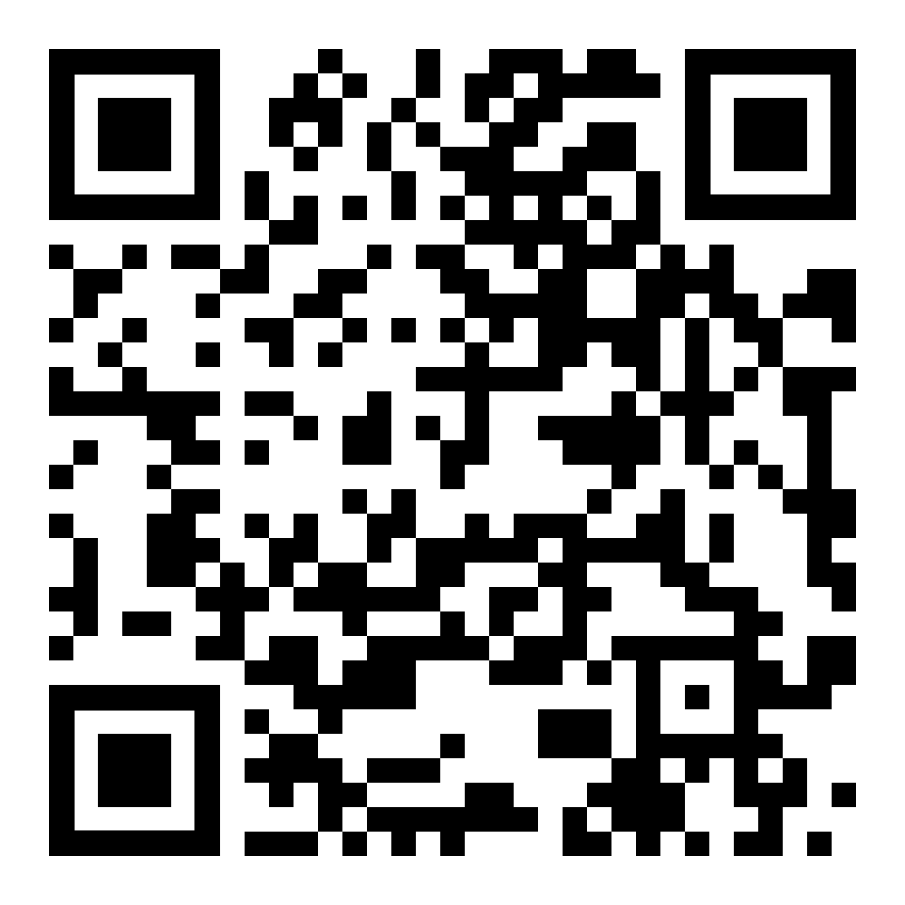
Sharing
• Trusting
• Securing
• Paying
Screening
• Interacting
• Forgetting
Cognifying
• Connecting
• Animating
• Accessing
Connecting
connect
_{🏡 Home} 📶 Wi-Fi router
3
_{🤖 Thing}
_{📶 Wi-Fi direct}
Why not
Wi-Fi Easy Connect?
connect
share
🤔
0
2
🧑‍🦰 Wallet: App
1
tap scan
🔆 NFC QR

Slide 39
Sharing
• Trusting
• Securing
• Paying
Screening
• Interacting
• Forgetting
Cognifying
• Connecting
• Animating
• Accessing
Animating
B
3
👥 Domain
create
👥 Domain
store files
👥 Domain
🖨️ Printer
🤖 Things
📦 Storage
2
check-in
A
🧑‍🦰 Wallet: App
C
order 🔆 NFC QR
subscribe 📦 storage
1
tap scan
🤖 Thing
🔆 NFC QR

Slide 40
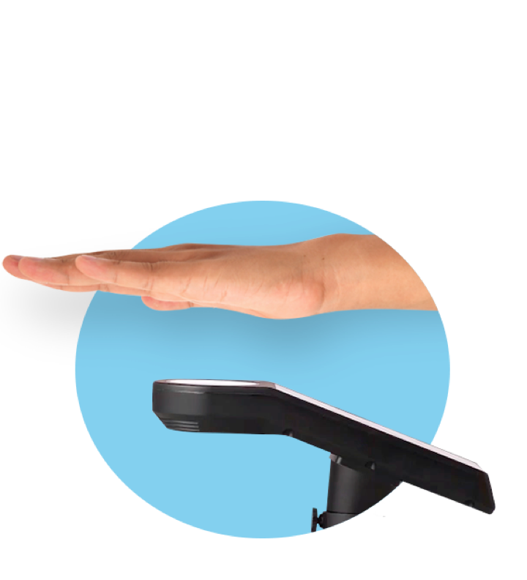
Sharing
• Trusting
• Securing
• Paying
Screening
• Interacting
• Forgetting
Cognifying
• Connecting
• Animating
• Accessing
Assessing
A
C
👥 Domain
register
👥 Domain
share?
👥 Domain
🖐️ Palmist
🆔 Biometric
🃏 Issuer
🖐️ scan palm
🛂 show passport
🔑 issue token
issue
D
B
bind
🧑‍🦰 Wallet: App
🔑 store token
2
print
E
scan palm
scan QR
👥 Domain
1
📄 Printed
🔎 Consumer
✨ QR Credential
Notes:
Biometrics: Uses and Abuses https://www.schneier.com/essays/archives/1999/08/biometrics_uses_and.html
How does Pico work? https://www.cl.cam.ac.uk/~fms27/pico/technical/

Slide 41
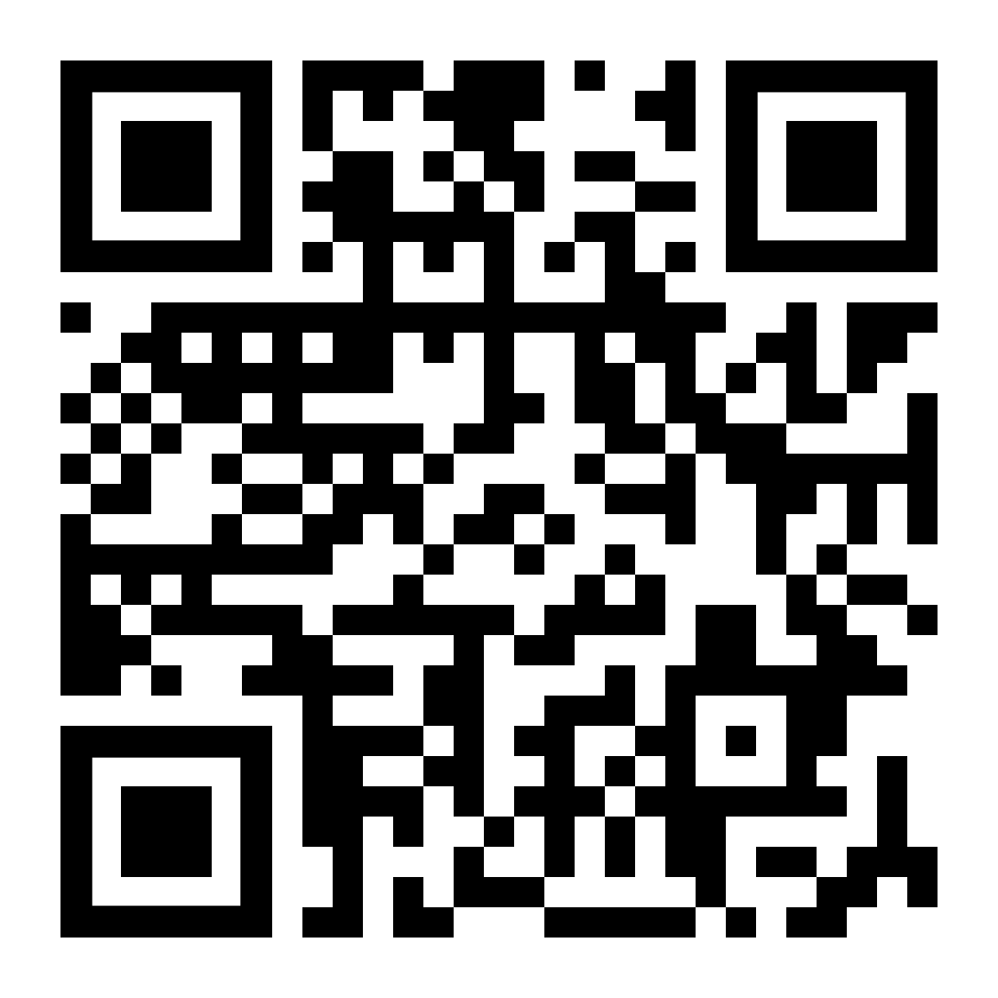
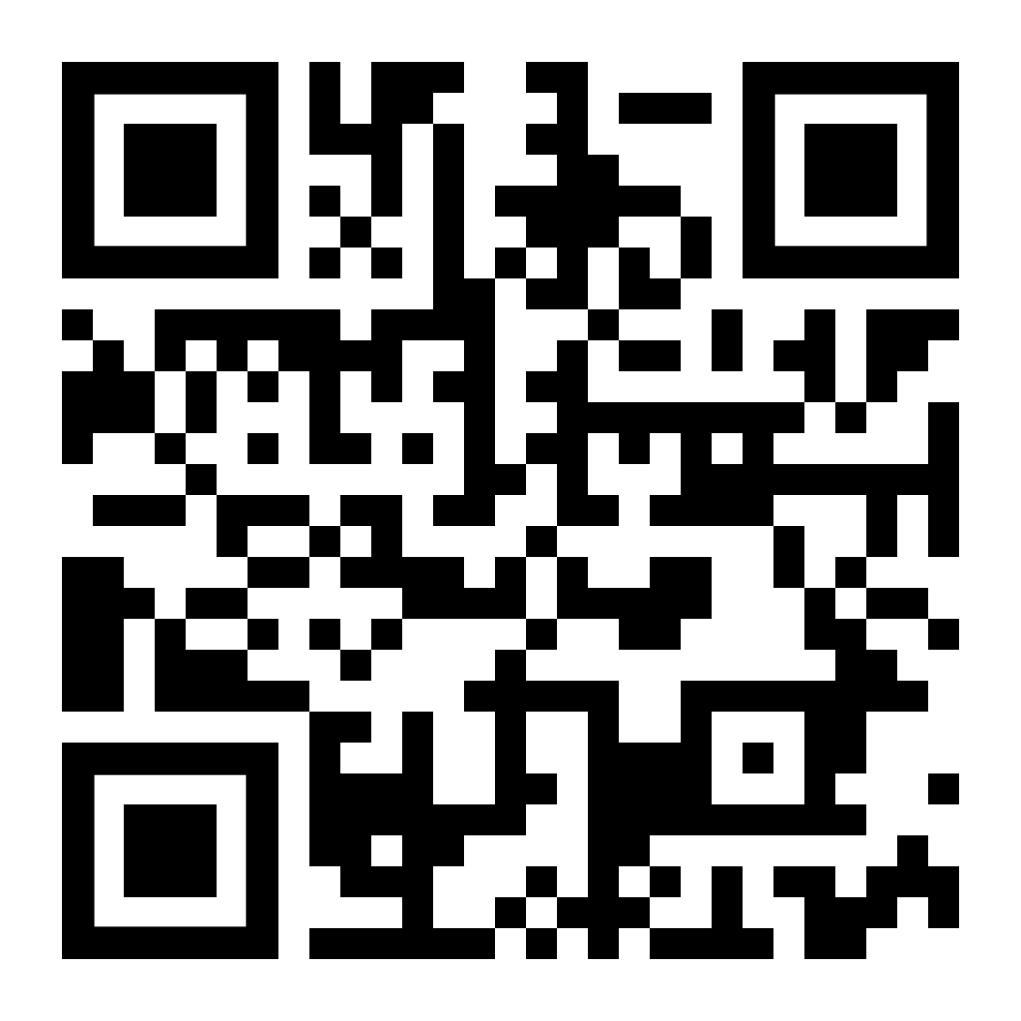
Sharing
• Trusting
• Securing
• Paying
Screening
• Interacting
• Forgetting
Cognifying
• Connecting
• Animating
• Accessing
Assessing
A
C
👥 Domain
register
👥 Domain
share?
👥 Domain
🖐️ Palmist
🆔 Biometric
🃏 Issuer
Same as
Pico: no more passwords?
🖐️ scan palm
🛂 show passport
🔑 issue credential
🤔
issue
D
B
bind
🧑‍🦰 Wallet: App
🔑 store credential
Why not
offline QR face hash?
2
print
E
scan palm
scan QR
👥 Domain
1
🤔
📄 Printed
🔎 Consumer
✨ QR Credential
Notes:
Biometrics: Uses and Abuses https://www.schneier.com/essays/archives/1999/08/biometrics_uses_and.html
How does Pico work? https://www.cl.cam.ac.uk/~fms27/pico/technical/

Slide 42
Next steps

Slide 43

Jorge Fonseca (he/him)
linkedin.com/in/jorgefonseca

Slide 44
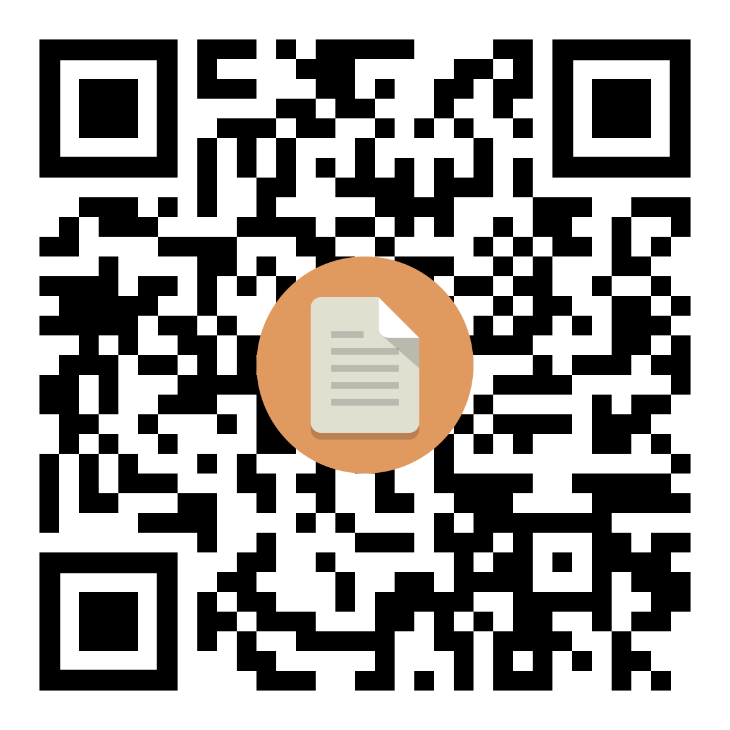
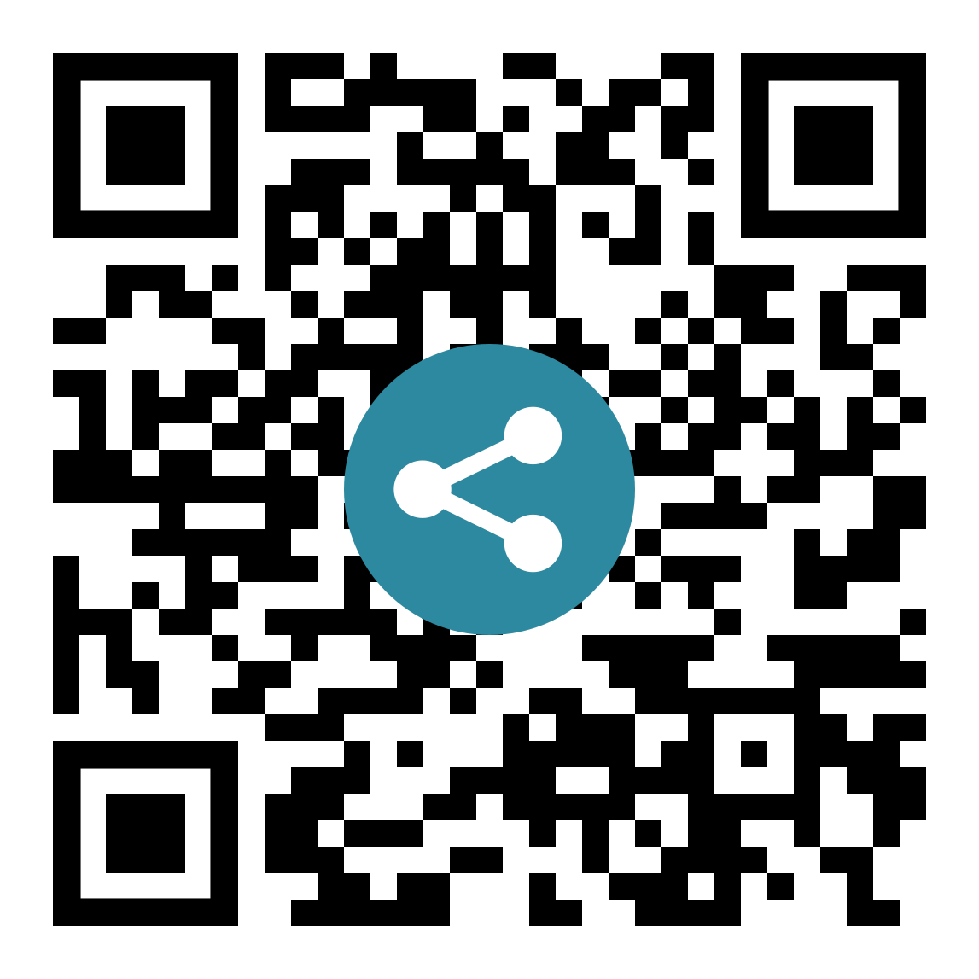
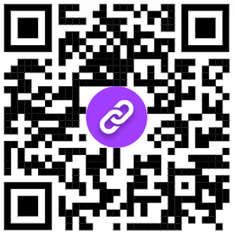
Sharing
• Trusting
• Securing
• Paying
Screening
• Interacting
• Forgetting
Cognifying
• Connecting
• Animating
• Accessing
Test bench
Real-life examples Business ideas Data schemas
API definitions
Actors’ specifications Sequence diagrams Cloud architectures
Source code
Deployable cloud stacks, workflows, and functions
tinyurl.com/dtfw-tests
tinyurl.com/dtfw-api
tinyurl.com/dtfw-code

Slide 45
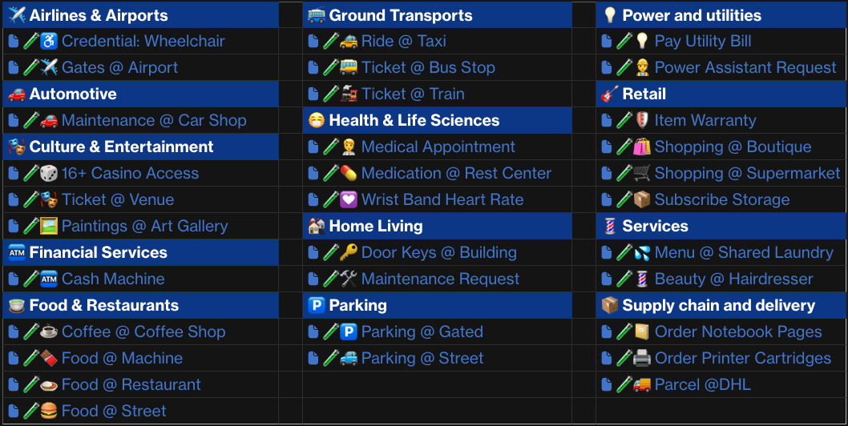
🧑‍🔬 Test bench
📜 Manifests ⚙️ Sequences 💬 Dialogs 🅰️ API calls
Test bench

Slide 46
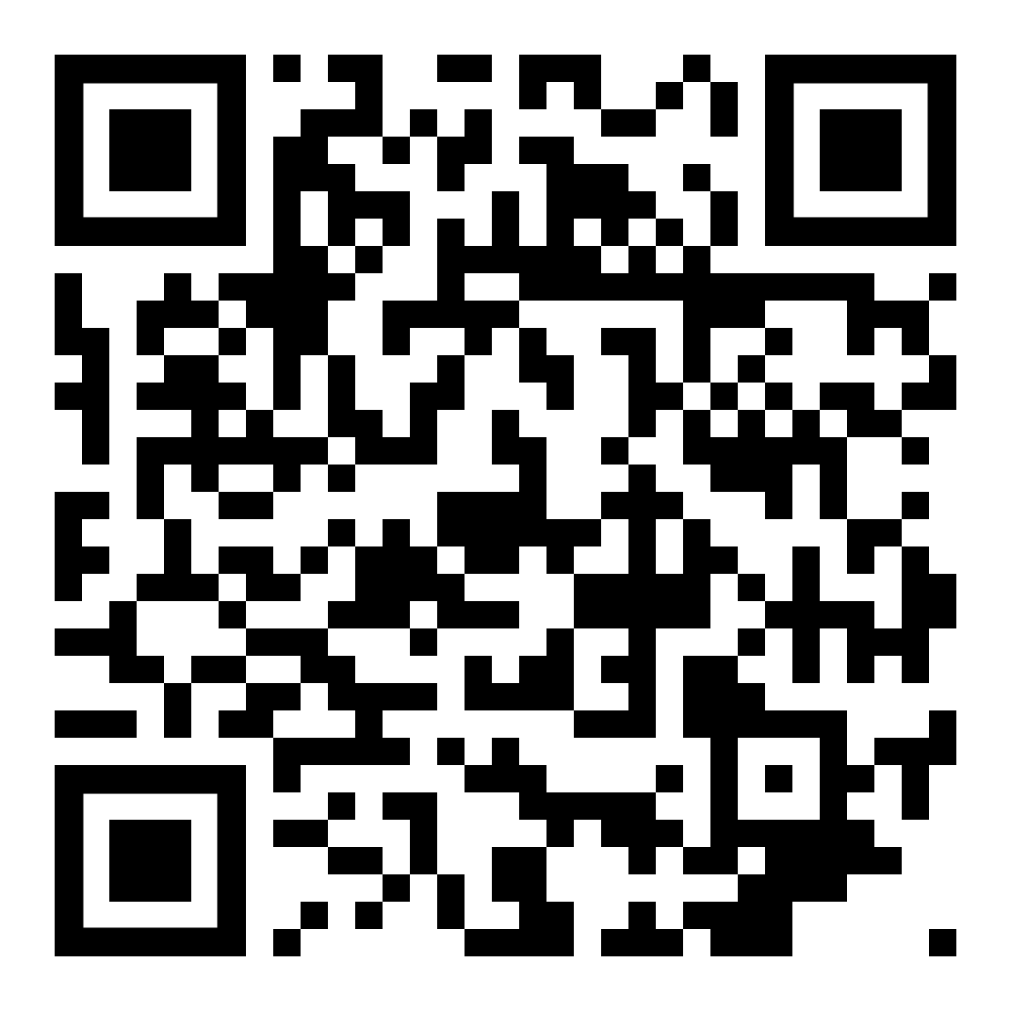
🧪♿ Credential: Wheelchair
references
📜 manifests
calls
🔥 Firewall
💺🏛️ ICAO.int
🤝 DTFW.org
💺🏛️ IATA.org
♿ IATA-SSR.org
🇬🇧 Gov.uk
🇺🇳 UN.org
🇫🇷💺 Air France
🇪🇺 Europa.eu
🇬🇧🏥 NHS.uk
🇲🇹 Gov.mt
🇮🇹 Governo.it
👂AnyListener.org
🧑‍🦰 AnyWallet.com
🕸️ AnyGraph.org
🤵 AnyBroker.com
🧪♿

Slide 47
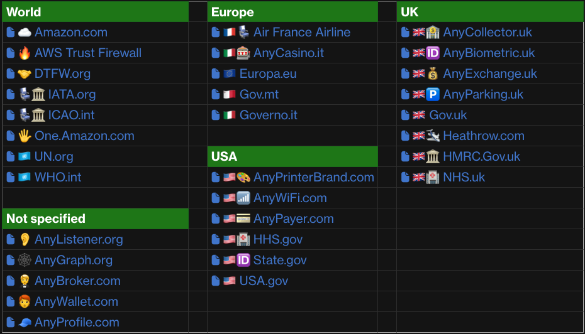
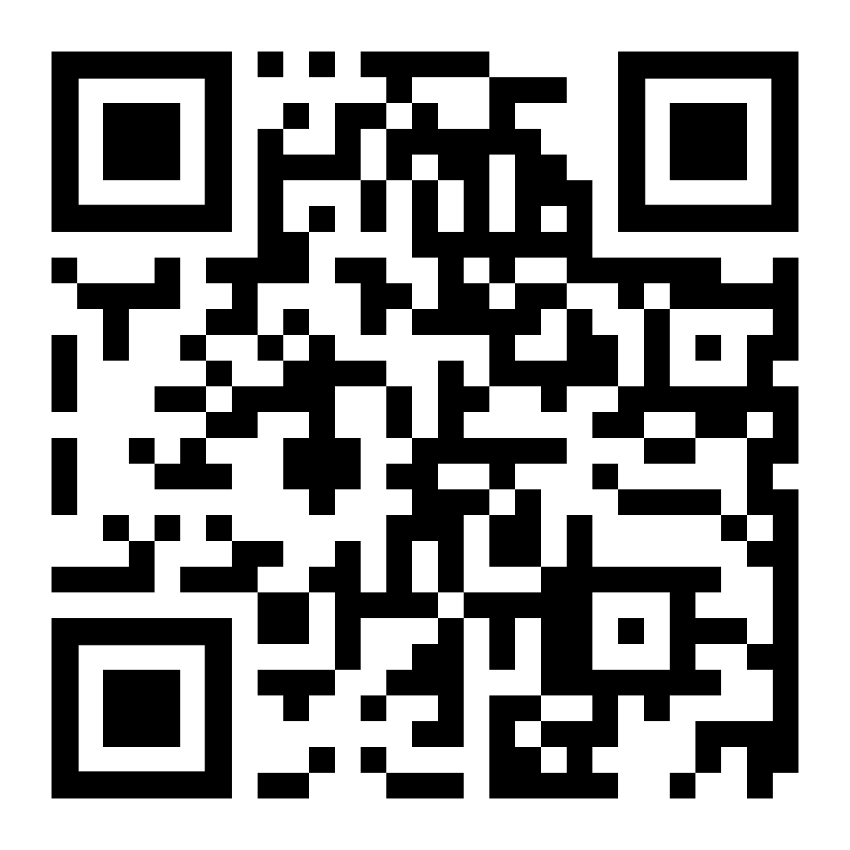
📜 Manifests
📜

Slide 48
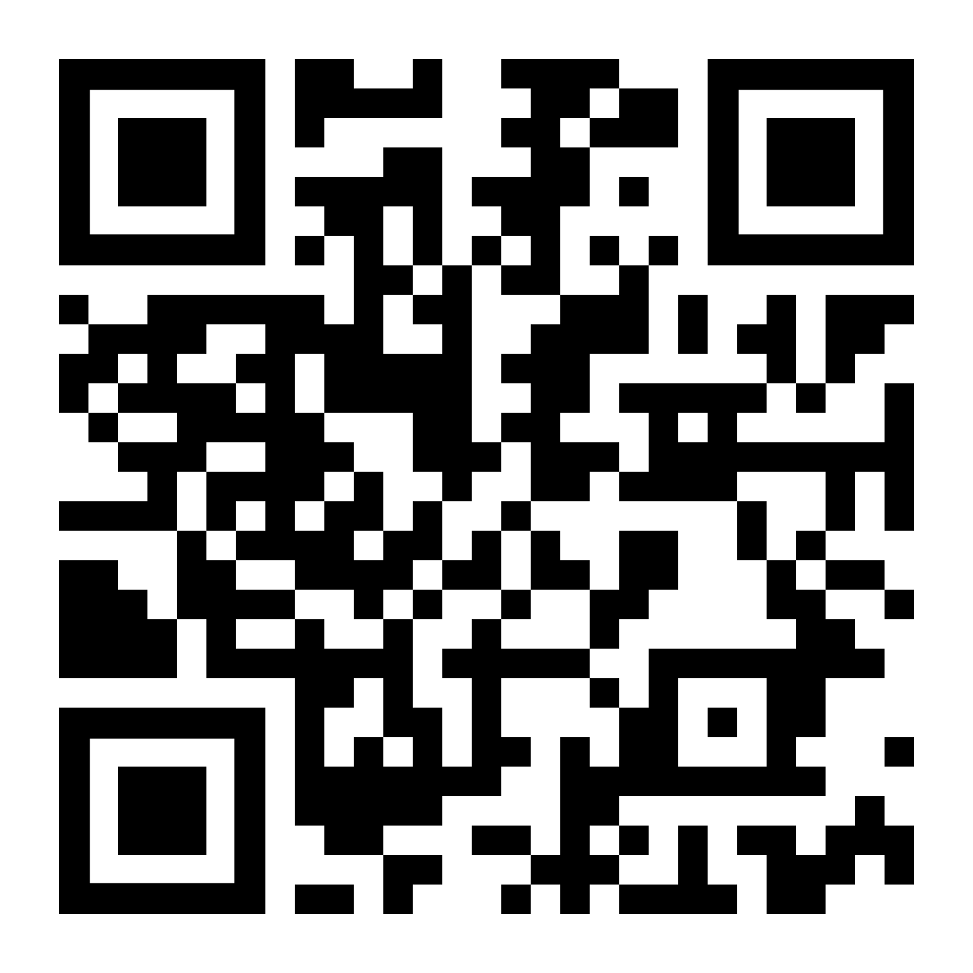
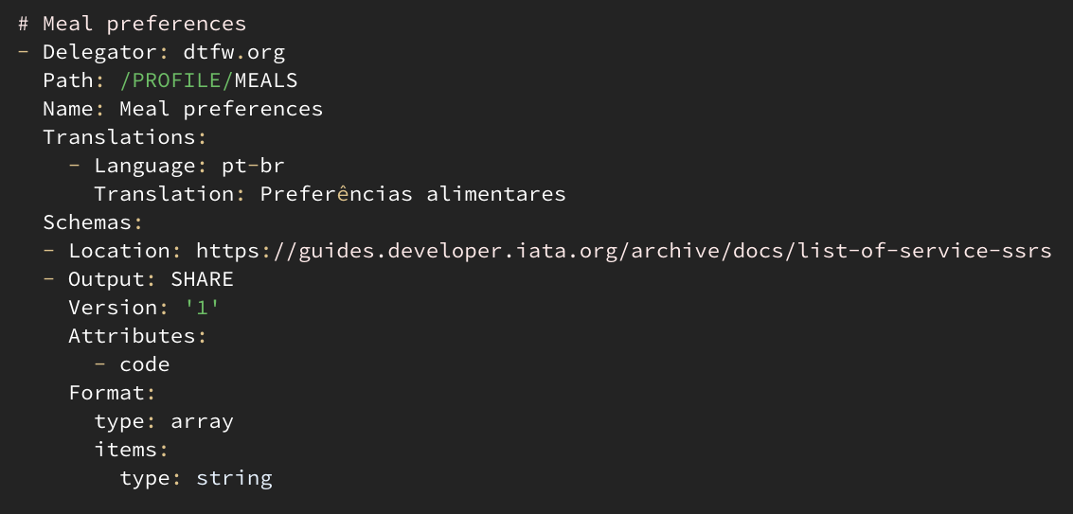
🤝 DTFW.org manifest
🏦 Bank 🤵 Broker 💰 Exchange 🤗 Host 🖐️ Palm 💳 Pay 🧢 Profile 📦 Storage 📶 Wi-Fi
🧩 /PROFILE
🧩 //DELIVERY
🧩 //BILLING
🧩 //EMERGENCY
🧩 //ALLERGIES
🧩 //PHONE
🧩 //BOOKING
🧩 //MEALS
🧩 //SOCIAL/NAME
🧩 //SOCIAL/FRIENDLY
🧩 //PARKING
🧩 //TRAVEL/GROUP
🧩 //TRAVEL/SEAT
🧩 //TRAVEL/TAXI
🧩 //TRAVEL/PLACE
📜

Slide 49
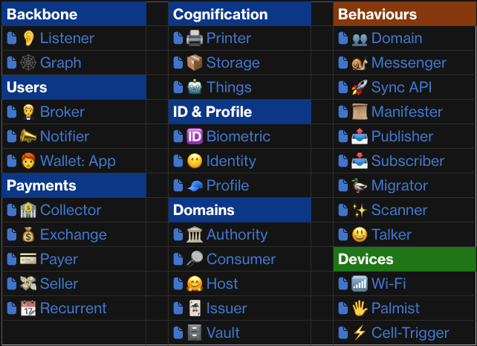
API definitions
API definitions

Slide 50
API definitions
👉 Responsibilities 🖥️ Screens ⚙️ Sequence flows 🗺️ Architectures 😃 Talkers 🧠 Definitions 🪣 Persistence 🅰️ API methods - 🚀 Synchronous
- 🐌 Async
API definitions

Slide 51
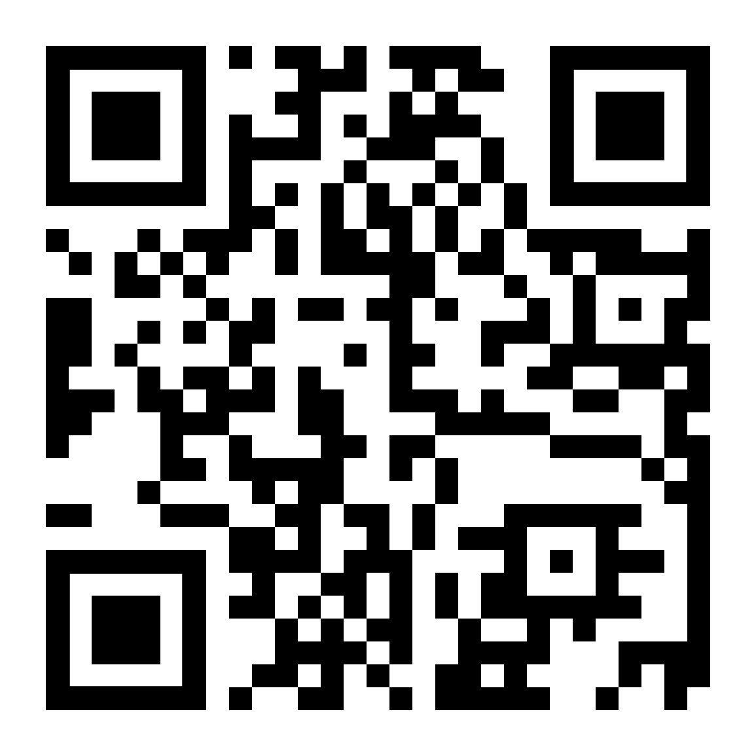
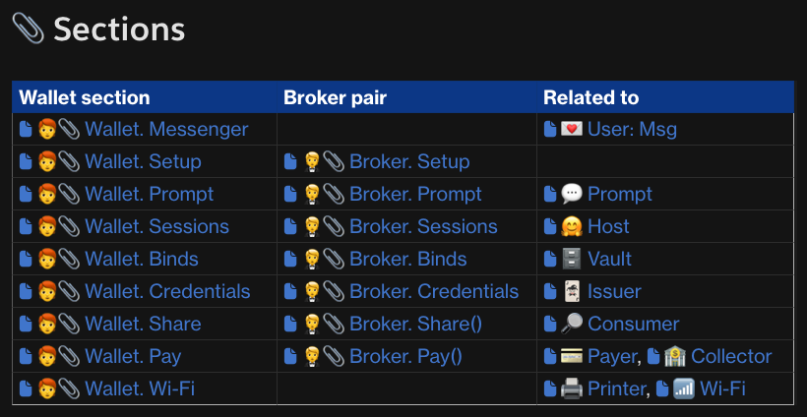
API definitions

Slide 52
Takeaways
Cognifying
Connect/cognify nearly all things/places/services
UI framework to interact with nearly everything Alternative to W3C DIDs, DIDcomm, and VCs
+ Decentralized domain trust framework
+ Decentralized data mesh for online sharing
+ Supervised biometric verification of credentials
Screening
Sharing

Slide 53
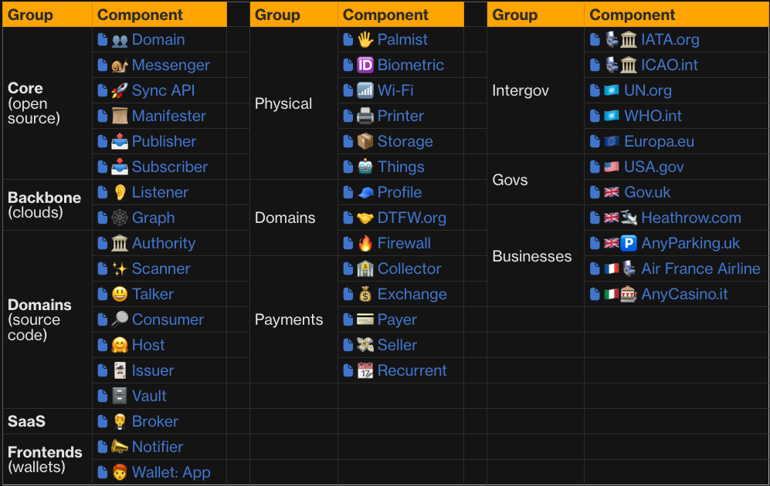

Call to action
Source code

Slide 54
Jorge Fonseca (he/him)
linkedin.com/in/jorgefonseca

